Slide 1


Upward Bound APR Data Analysis
Simpson University TRIO Programs Servicing Shasta and Siskiyou's County By: Anthony Zippay

Slide 2
Purpose and Overview of Project
A study to identify key performance indicators and the factors that influence them
A study to identify program improvements
Not a study to improve APR reporting

Slide 3
Essential Research Questions
Does participation in our Upward Bound activities improve academic performance and post-secondary enrollment?
Are there types of activities that are weighted more heavily in determining whether or not we meet our objectives?
What factors mostly contribute to achieving our objectives?
What data collection needs can we identify for future evaluations?

Slide 4
Datasets
2018 and 2019 Program Years
Student Contact Data
16,000+ records
Student Specific Academic and Graduation Data
318 unique students

Slide 5
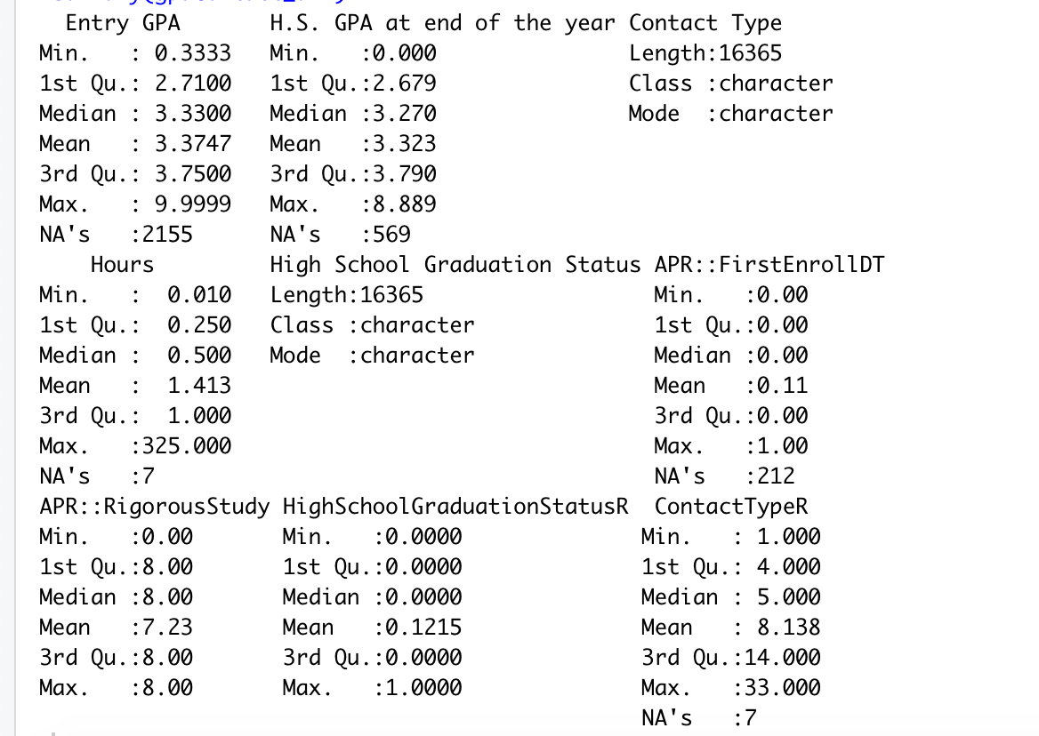
Basic statistics of datasets
Contact Type, Graduation, Rigorous and Recoded variables need explanation or need to be transformed again before showing this

Slide 6
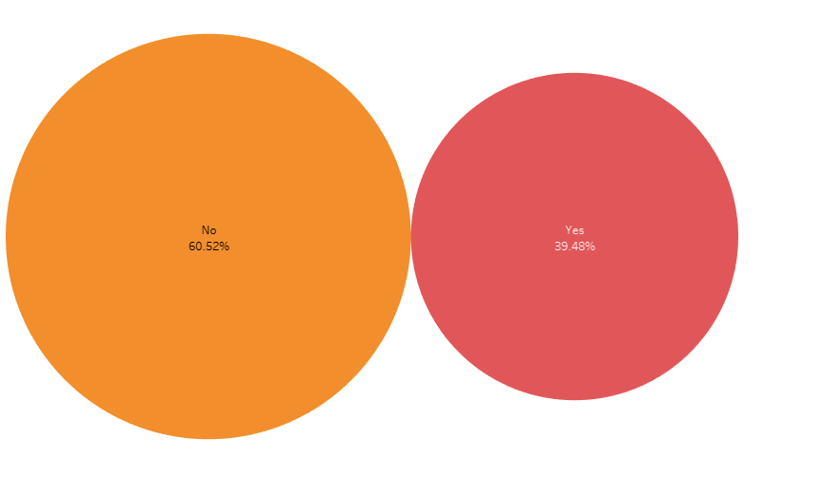
Almost half of our students are at risk of academic failure
60.52%
No
39.48%
Yes

Slide 7
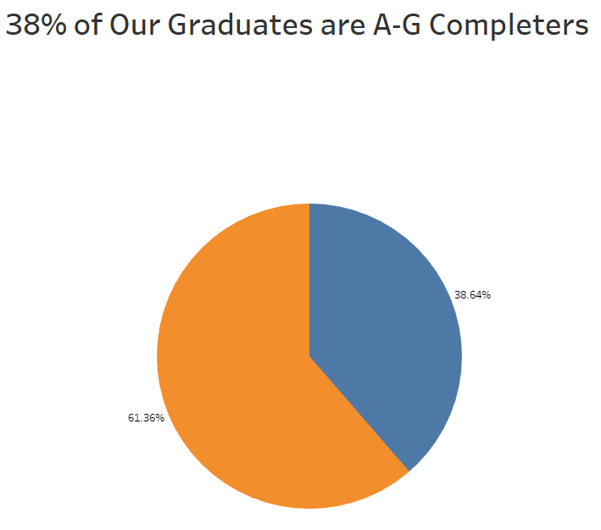
Rigorous Study
38.64%
Yes
61.36% NO

Slide 8
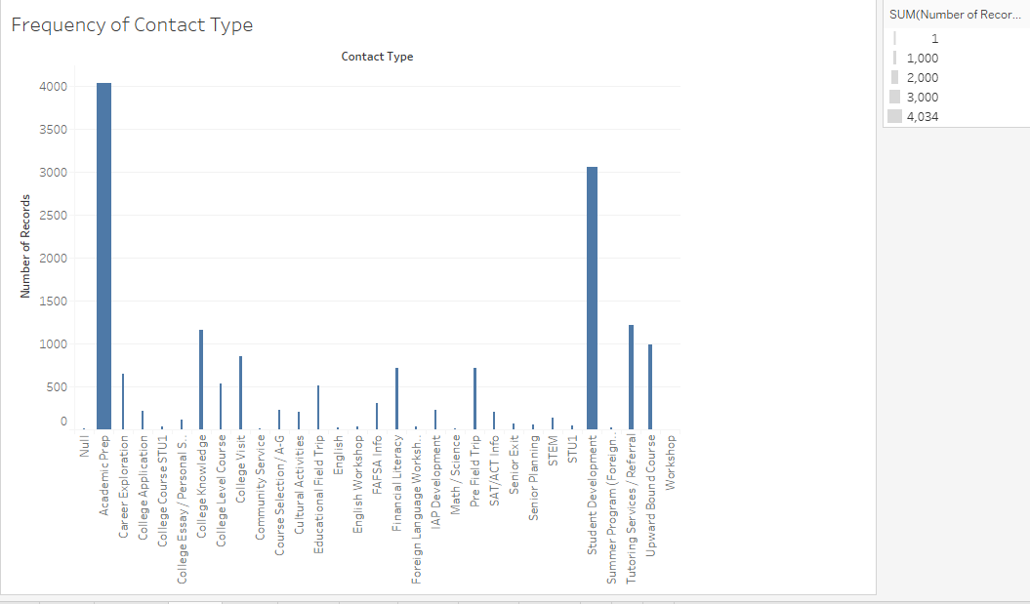
The most often recorded contact types are Academic Prep and Student Development

Slide 9
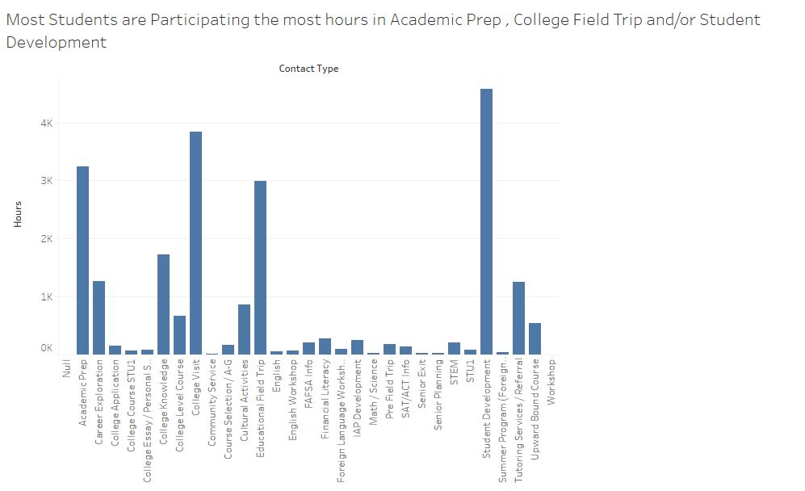
In terms of hours spent on a specific activity, Student Development tops the list
Academic Prep
College Visit
Student Development

Slide 10
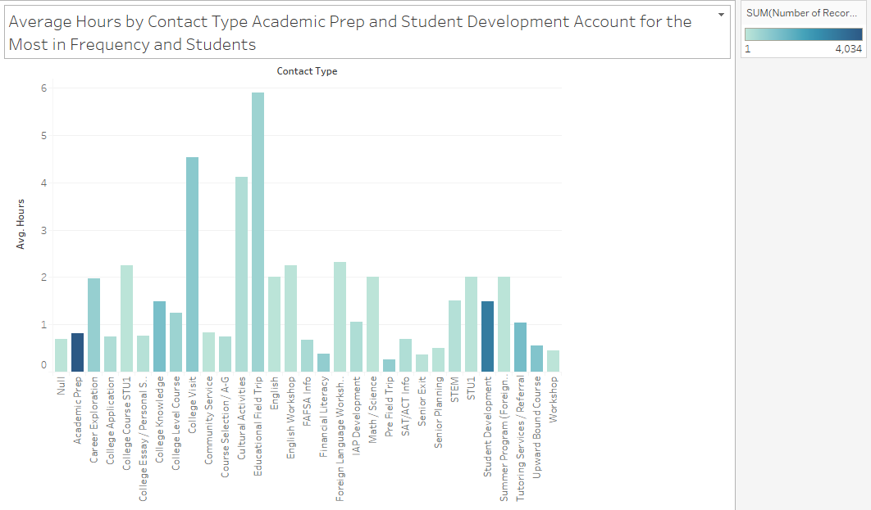
Academic Prep and Student Development are not significant in terms of hours spent per student
College visits are both significant in terms of Avg. time per student and Total hours
Field trip activities
significant p values
While Acad prep & Stu Dev
significant relationship to hours
Academic Prep and Students Development = much less time in terms of Avg hours per student

Slide 11
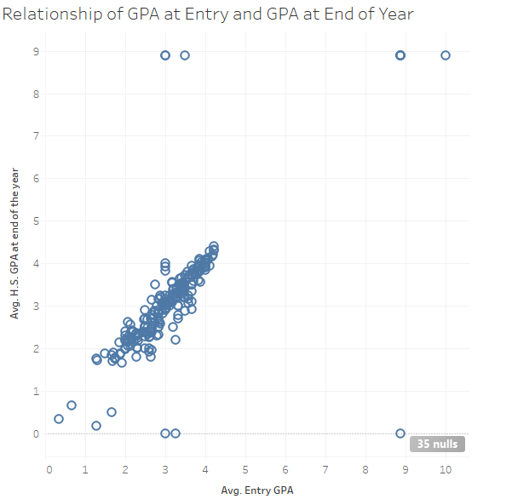
There is almost no difference in GPA at Entry vs. End of the Year
Takeaways:
We could use more interval data on GPA
35 nulls out of 318
There are some outliers

Slide 12
What insights can we gain about performance and meeting our objectives?
We identified the factors that we are spending the most time on
Academic Prep
College Visits
Educational Field Trips
Student Development
Cultural Activities
Now we need to know which of these if any have the most influence on academic performance and college enrollment

Slide 13
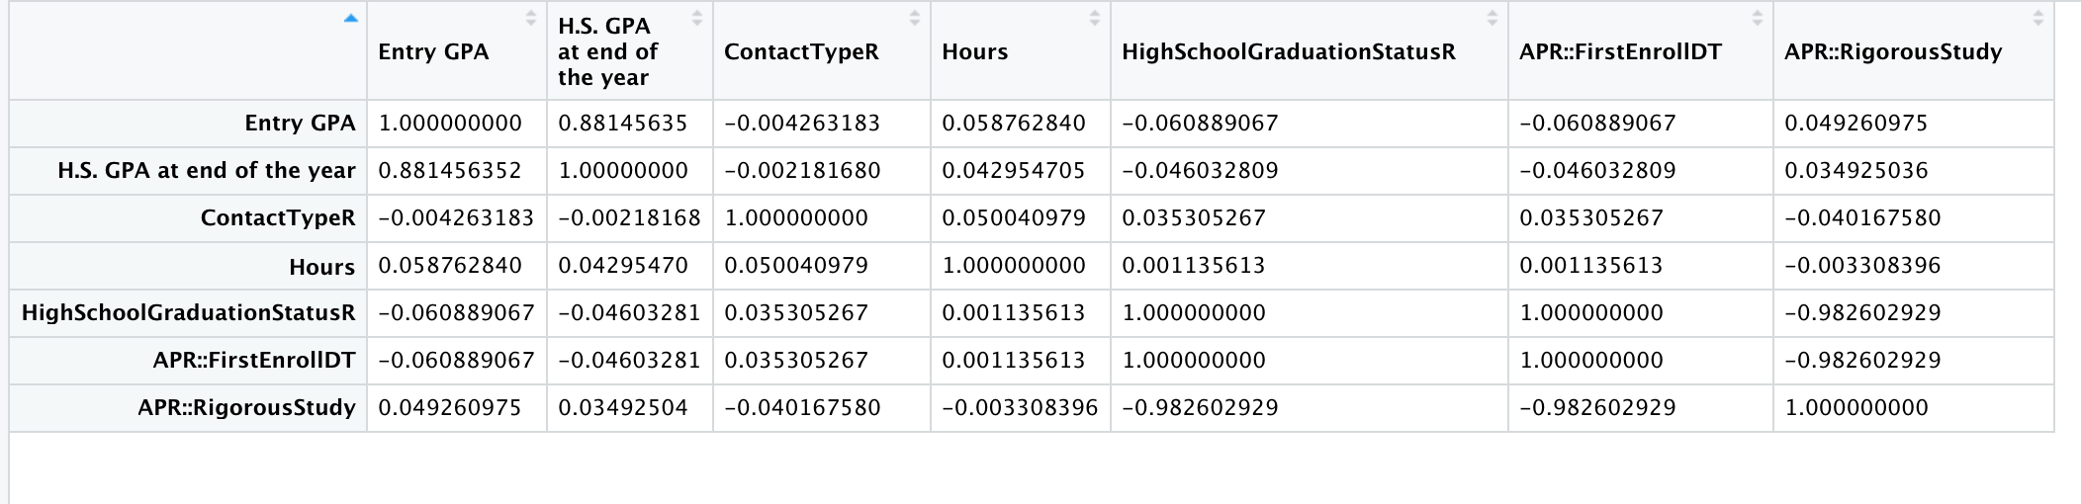
Correlation Matrix to confirm variables of interest
Low correlation between contact type/hours and graduation/postsecondary enrollment
Note: replace matrix with colored version
Our rate of post-secondary enrollment was so high for students that graduated high school
Extremely high correlation between Graduation and Post-secondary enrollment (sample size is small)
Good correlation of GPA to graduation and post-secondary enrollment

Slide 14
Assumptions of Homogeneity
Data met all assumptions for heterodasticity, except high school graduation-post secondary enrollment as well as entry GPA and End of Year GPA.
Small sample size
100% of our high school graduates enrolled in post-secondary
GPA is the same with little no difference in recorded data

Slide 15
Regression Analysis was Used to identify significant relationships as well as cause and effect of those relationships
Is there a relationship between our Contacts, workshops and activities and our program objectives?
Regression analysis should give us a good understanding of a cause and effect relationship if it exists.

Slide 16
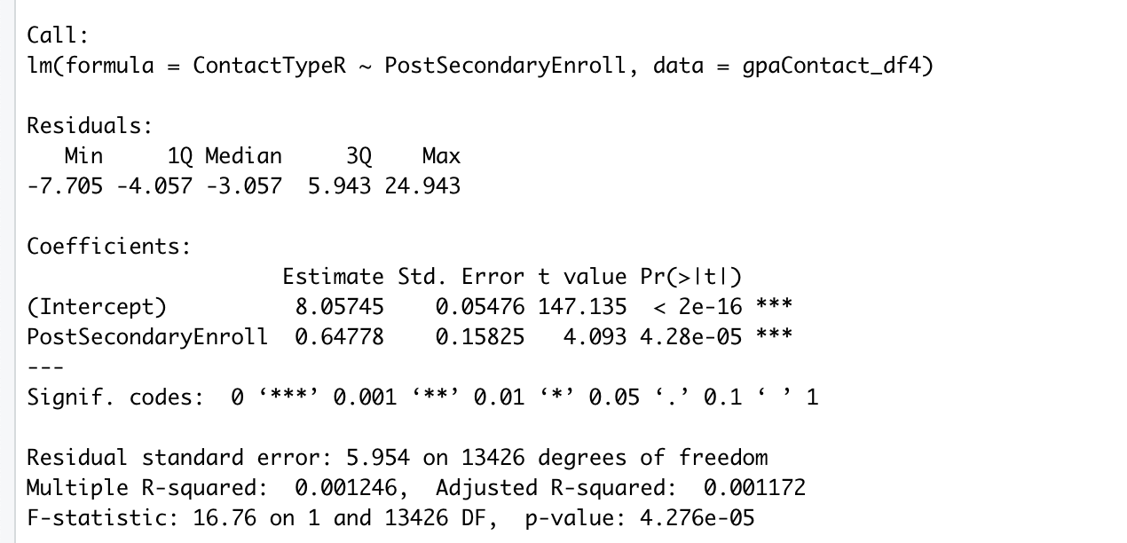
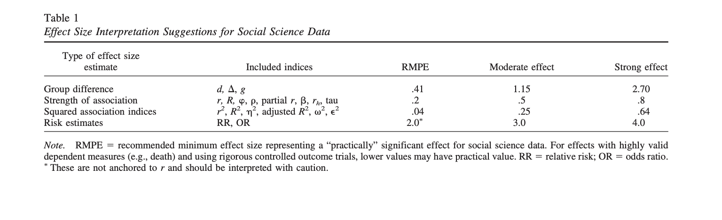
Contact Type and Post-Secondary Enrollment Have a Relationship but is it worth talking about?
The effect size being so small (.001) makes this relationship much less significant. But it could be due to the high number of values (33) we see in this variable.

Slide 17
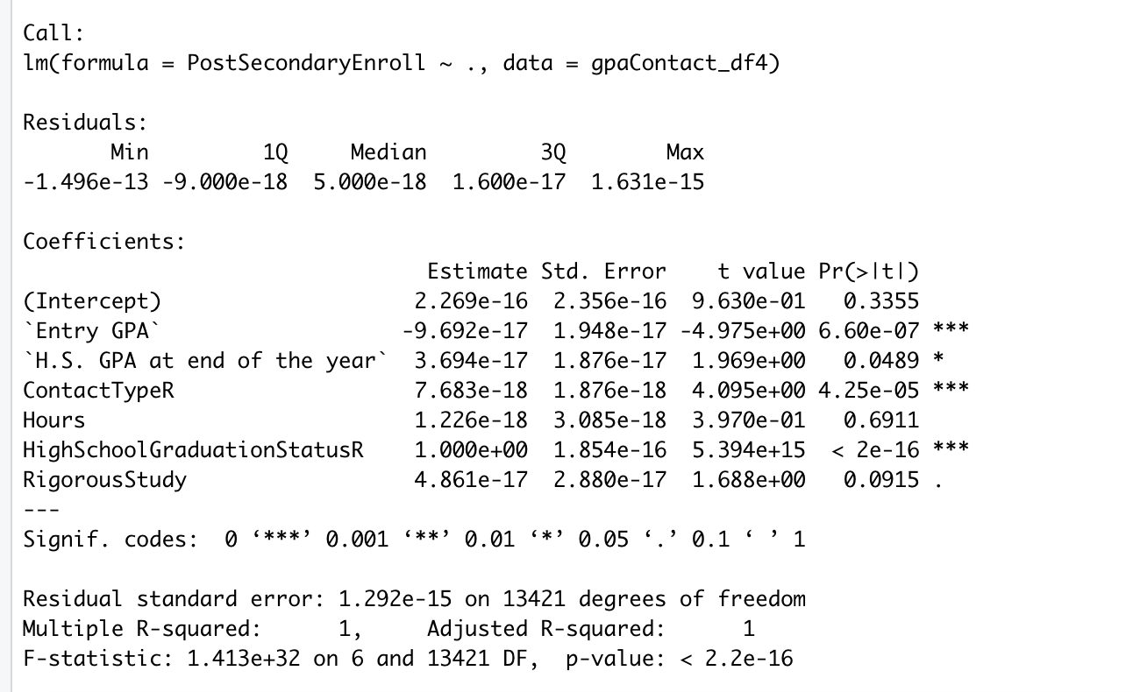
Checking the relationship of each variables significance to Post Secondary enrollment we find that many variables are significant
Contact Type is more significant than Hours

Slide 18
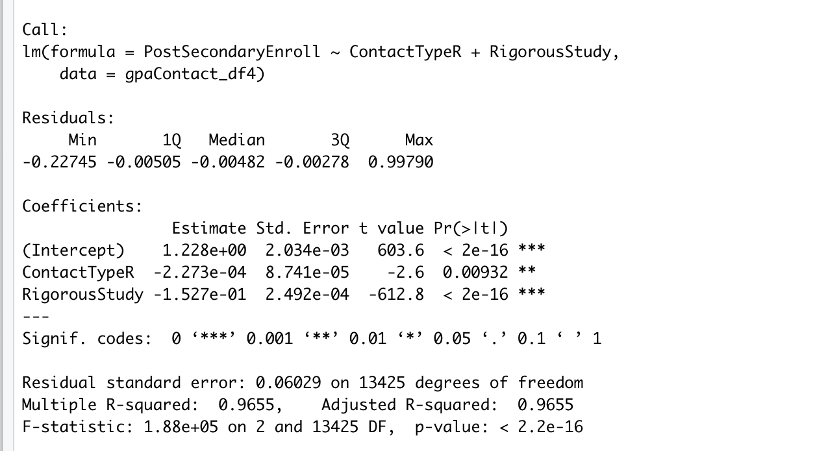
Modified Linear Model Post-Secondary Enrollment
Contact Type + Rigorous Study explain 95% of the variance in Post Secondary Enrollment

Slide 19
Looking Deeper at Contacts
For further study, machine learning and feature importance

Slide 20
Can we predict the success of our students based on our program activities?
Yes, possibly but we need more than just contacts to meet objectives.
As we meet 1 objective, more objectives follow suit. Due to their strong relationship to each other.

Slide 21
Conclusions
The small sample size should be taken into consideration
But meeting the assumptions of homogeneity suggest that there is a lack of multicolinearity and therefore we can assume that sample size is not as much of an issue as you might think
GPA variance non existent
This seems so strange to me, maybe if we collected semester GPA data we would see more change in this.
Contact Type is more significant indicator of postsecondary enrollment than Hours. This could mean that the specific activity has more weight than the time spent on that activity.
By combining Contact Type data with Rigorous Study, we can successfully predict Post Secondary Enrollment. This places an importance on program participation and A-G Completion in order to achieve Post Secondary Enrollment. And due to fact that Rigorous Study by itself is not a significant predictor value for Post Secondary Enrollment we can also conclude that Contacts are a valuable component
Questions still remain on which contacts are most important.
Further analysis could reveal an answer to this question

Slide 22
Recommendations for Data Collection
A-G on track status (UC and CSU)
Student Intent on Post-Secondary Enrollment
Intended Major in College
Semester GPA
Work study student participants

Slide 23
Future Analysis
Take a deeper look at contact types. Could create a new variable for each group or run feature importance.
Which contact types play the most significant role in predicting Post-Secondary Enrollment?

